Slide 1
The synoptic digital scholarly edition: a third way
Paolo Monella
Textual Philology Facing Liquid Modernity
Sapienza Università di Roma, April 18, 2018

Slide 2
Liquid modernity
Print: apparatus criticus
Constitutio textus

Slide 3
Liquid modernity
Print: apparatus criticus
Scholarly
digital edition: synopsis
Constitutio textus
Doc

Slide 4
Liquid modernity
Print: apparatus criticus
Scholarly
digital edition: synopsis
Constitutio textus
New
Philology
Doc

Slide 5
Print
Substantial readings et iuxta / iuxta vero
Spelling optimus / optumus septuaginta / lxx
Paleographic
Abbreviations interpretes / interp’etes
Allographs iuxta / juxta
Punctuation lxx / .lxx.

Slide 6
Digital
iuxta
septuaginta
uero
interpretes
et
iuxta
<choice>
<orig>lxx</orig>
<reg>septuaginta</reg>
</choice>
inter
<choice>
<abbr>p’</abbr>
<expan>pr</expan>
</choice>
etes
iuxta
septuaginta
uero
interpretes.´
et
iuxta
.lxx.
interp’etes.
Vat. Lat.
3973
S. Peter
E 22

Slide 7
Digital
iuxta
septuaginta
uero
interpretes
Substantial readings
et
iuxta
<choice>
<orig>lxx</orig>
<reg>septuaginta</reg>
</choice>
inter
<choice>
<abbr>p’</abbr>
<expan>pr</expan>
</choice>
etes
Spelling
Paleographic
iuxta
septuaginta
uero
interpretes.´
et
iuxta
.lxx.
interp’etes.
Vat. Lat.
3973
S. Peter
E 22

Slide 8
Digital
iuxta
septuaginta
uero
interpretes
et
iuxta
<choice>
<orig>lxx</orig>
<reg>septuaginta</reg>
</choice>
inter
<choice>
<abbr>p’</abbr>
<expan>pr</expan>
</choice>
etes
Automatic
collation
iuxta
septuaginta
uero
interpretes.´
et
iuxta
.lxx.
interp’etes.
Vat. Lat.
3973
S. Peter
E 22

Slide 9
Digital
iuxta
septuaginta
uero
interpretes
Substantial readings
et
iuxta
<choice>
<orig>lxx</orig>
<reg>septuaginta</reg>
</choice>
interpretes
<choice>
<abbr>p’</abbr>
<expan>pr</expan>
</choice>
etes
Constitutio
textus

Slide 10
Digital
iuxta
septuaginta
uero
interpretes
Substantial readings
et
iuxta
<choice>
<orig>lxx</orig>
<reg>septuaginta</reg>
</choice>
interpretes
<choice>
<abbr>p’</abbr>
<expan>pr</expan>
</choice>
etes
Spelling
Constitutio
textus
History of language

Slide 11
Digital
iuxta
septuaginta
uero
interpretes
Substantial readings
et
iuxta
<choice>
<orig>lxx</orig>
<reg>septuaginta</reg>
</choice>
inter
<choice>
<abbr>p’</abbr>
<expan>pr</expan>
</choice>
etes
Spelling
Paleographic
Constitutio
textus
History of language
History of writing

Slide 12
Digital
iuxta
septuaginta
uero
interpretes
Substantial readings
et
iuxta
<choice>
<orig>lxx</orig>
<reg>septuaginta</reg>
</choice>
interpretes
<choice>
<abbr>p’</abbr>
<expan>pr</expan>
</choice>
etes
Constitutio
textus

Slide 13
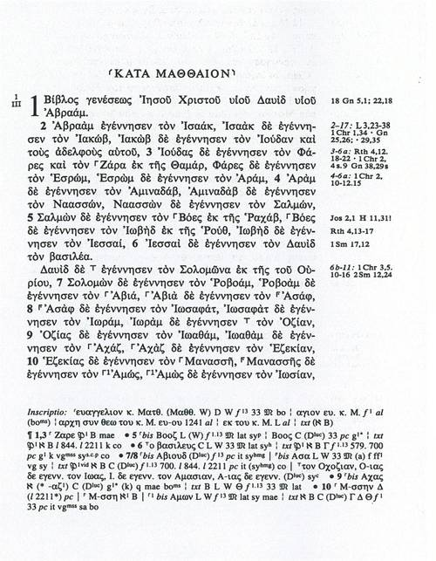
Digital
Substantial readings
et
iuxta
<choice>
<orig>lxx</orig>
<reg>septuaginta</reg>
</choice>
interpretes
<choice>
<abbr>p’</abbr>
<expan>pr</expan>
</choice>
eteso
Digital
added value?
Constitutio
textus

Slide 14
Digital
iuxta
septuaginta
uero
interpretes
Substantial readings
et
iuxta
<choice>
<orig>lxx</orig>
<reg>septuaginta</reg>
</choice>
inter
<choice>
<abbr>p’</abbr>
<expan>pr</expan>
</choice>
etes
Spelling
Paleographic
Constitutio
textus
History of language
History of writing

Slide 15
Liquid modernity
iuxta
septuaginta
uero
interpretes
Substantial readings
et
iuxta
<choice>
<orig>lxx</orig>
<reg>septuaginta</reg>
</choice>
inter
<choice>
<abbr>p’</abbr>
<expan>pr</expan>
</choice>
etes
Spelling
Paleographic
Constitutio
textus
History of language
History of writing

Slide 16
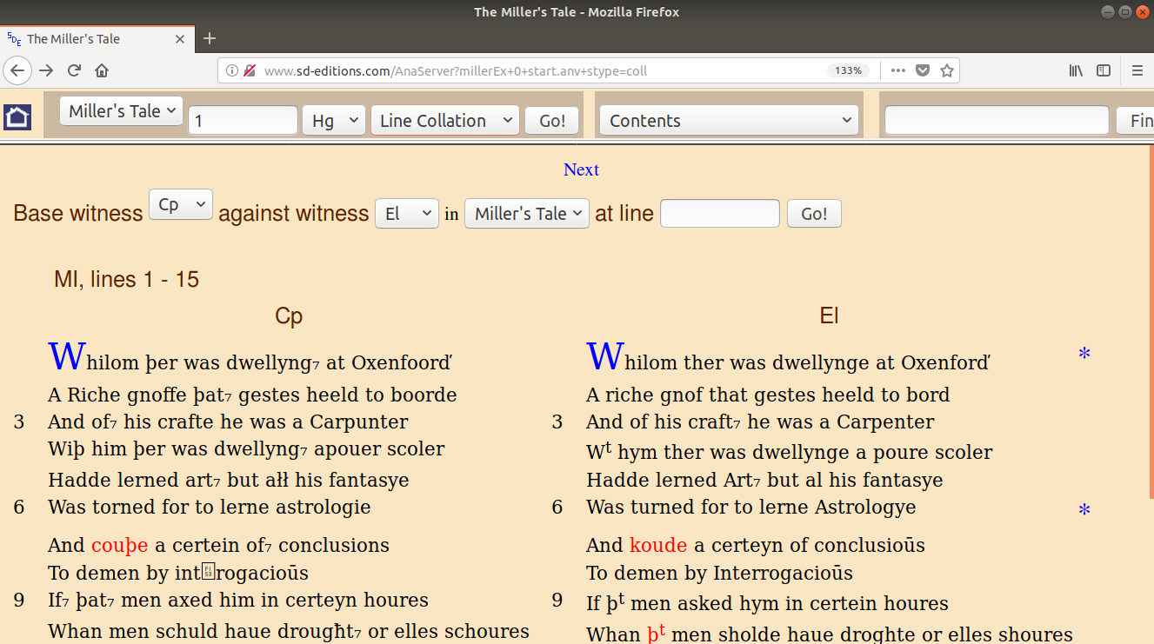
Liquid modernity

Slide 17
Liquid modernity
Print: apparatus criticus
Scholarly
digital edition: synopsis
Constitutio
textus
Doc
New
Philology

Slide 18
Liquid modernity
Print: apparatus criticus
Scholarly
digital edition: synopsis
Constitutio
textus
Doc
New
Philology
Doc
Constitutio
textus

